Slide 1


WHAT IS A DATABASE AND WHY DO WE USE THEM?
A database is an organized collection of structured information, or data, typically stored electronically in a computer system
Apps that save data use databases, for example if an app has users then it'll save their login details.
What apps would not need a database?

Slide 2
Benefits of using databases:
Can handle large amounts of data
data can easily be updated
data can accurately be updated
data is secure
we can easily ensure we are not storing redundant data

Slide 3
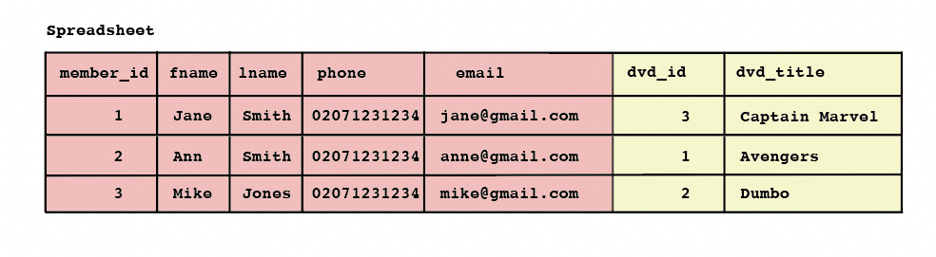
How does a relational database differ from a spreadsheet?

Slide 4
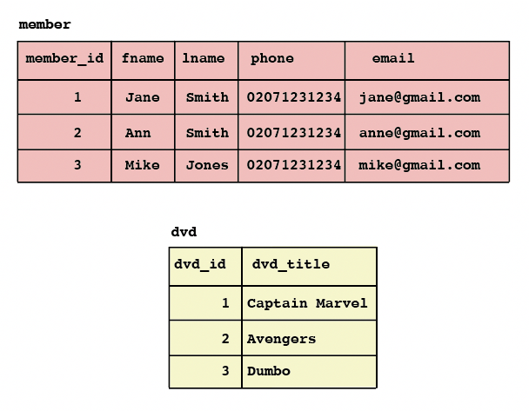
A relational database management system (RDBMS)
Rows are also called records or tuples. Columns are also called attributes.
Data is broken down into one or more tables (or "relations") of columns and rows, with a unique key identifying each row. This unique key is called a Primary Key (PK).
Generally, each table represents one "entity type" (e.g. member or dvd)
The rows represent “instances” of that type of entity (such as "Jane") and the columns representing values attributed to that “instance” (such as name, phone and email).

Slide 5
ONE TO ONE RELATIONSHIPS - like user to username
id (PK) | name | user_name
1 | JEM | J_EM
2 | SHAHY | SHAZ123
3 | GHASSAN | GHAZA
Can put them in one table like this
OR…
…across two tables using foreign keys to reference the other table. A primary key is a key that is in its own table e.g. user_id in the users table, but if this key is used in another table it would be a foreign key.
UNIQUE
USERS
USERNAMES
id (PK) | name
1 | JEM
2 | SHAHY
3 | GHASSAN
id (PK) | user_id (FK) | user_name
1 | 2 | SHAZ123
2 | 3 | GHAZA
3 | 1 | J_EM

Slide 6
ONE TO ONE RELATIONSHIPS
id (PK) | name | user_name
1 | JEM | J_EM
2 | SHAHY | SHAZ123
3 | GHASSAN | GHAZA
Can put them in one table like this
OR…
If this column wasn’t unique, then it would be a one to many relationship, because the user id could come up more than once (i.e. they could have more than one user name)
…across two tables using foreign keys to reference the other table. A primary key is a key that is in its own table e.g. user_id in the users table, but if this key is used in any other table it would be a foreign key.
UNIQUE
USERS
USERNAMES
id (PK) | name
1 | JEM
2 | SHAHY
3 | GHASSAN
Id (PK) | user_id (FK) | user_name
1 | 2 | SHAZ123
2 | 3 | GHAZA
3 | 1 | J_EM

Slide 7
ONE TO MANY RELATIONSHIPS
Student teacher relationships in primary school, the students have one teacher but the teacher has many students
STUDENTS
TEACHERS
Id (PK) | teacher_id (FK) | student_name
1 | 2 | HADIL
2 | 2 | SAED
3 | 1 | NOUR
4 | 1 | AMEEN
5 | 2 | YASMIN
6 | 1 | ISMAIL
7 | 1 | ALI
Id (PK) | name | gender
1 | NADIA | F
2 | MUSTAFA | M
WHICH STUDENTS HAVE NADIA AS A TEACHER?

Slide 8
ONE TO MANY RELATIONSHIPS
Student teacher relationships in primary school, the students have one teacher but the teacher has many students
STUDENTS
TEACHERS
Id (PK) | teacher_id (FK) | student_name
1 | 2 | HADIL
2 | 2 | SAED
3 | 1 | NOUR
4 | 1 | AMEEN
5 | 2 | YASMIN
6 | 1 | ISMAIL
7 | 1 | ALI
Id (PK) | name | gender
1 | NADIA | F
2 | MUSTAFA | M
WHICH STUDENTS HAVE NADIA AS A TEACHER?

Slide 9
MANY TO MANY RELATIONSHIPS
At University the relationship changes, teachers have many students but now students also have many teachers
TEACHERS_STUDENT TABLE
STUDENTS
TEACHERS
id (PK) | student_name
1 | HADIL
2 | SAED
3 | NOUR
4 | AMEEN
5 | YASMIN
6 | ISMAIL
7 | ALI
teacher_id (FK) | student_id (FK)
1 | 1
1 | 2
2 | 2
3 | 2
1 | 3
2 | 3
3 | 4
… | …
id(PK) | name | gender
1 | NADIA | F
2 | MUSTAFA | M
3 | MIRA | F
INTERMEDIARY TABLE

Slide 10
Schemas
Lets all create 3 different pets databases one for each of the following situation:
where each pet owner can only have one pet.
where a pet owner can have more than one pet
where pet owners can have more than one pet, AND pets can have more than one owner.

Slide 11
POSTGRES, LIBRARY …
 | Library analogy | Databases
Language | English | SQL (syntax differences between SQL and other languages) SQL commands are known as queries.
Database management system | Library | PostgreSQL, MySQL
Database | Collection of books (you will often have multiple collections of books in your library) | Database (you will often have multiple databases in your PostgresSQL)
Schema | Classification system | Schema
client | Library terminal, librarian (i.e. who you as a user interacts with in order to get information out of your library) | PSQL, PGCLI (i.e. who you as a user interacts with in order to get information out of your database)

Slide 12
How do we interact with our databases?
Using SQL queries. Most common commands:
To get data from tables you will use ‘SELECT’
E.g. SELECT * FROM teachers
E.g. SELECT name, gender FROM teachers
E.g. SELECT * FROM teachers WHERE name=‘NADIA’
To insert data into tables you will use ‘INSERT INTO’
E.g. INSERT INTO teachers VALUES (4, ‘shahy’, ‘F’)
E.g INSERT INTO teachers (name, gender) VALUES (‘shahy’, ‘F’)

Slide 13
SQLFIDDLE DEMO http://sqlfiddle.com/
Build a schema using this:
Write your query in the other box:
SELECT * FROM teachers;
CREATE TABLE teachers(
id SERIAL PRIMARY KEY,
name VARCHAR(255) NOT NULL,
gender VARCHAR(255) NOT NULL
);
INSERT into teachers VALUES (1, 'eade', 'F');

